Slide 1
Class 5
Python繪圖

Slide 2
📌Python海龜繪圖簡介
📌繪製幾何圖形
📌繪製數學函數圖形
📌使用Python繪製圖形

Slide 3
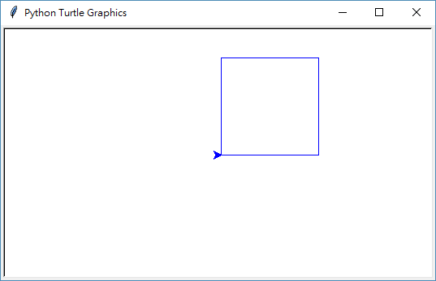
Python海龜繪圖簡介
基本格式
import turtle as tu
tu.color('blue')
for i in range(4):
tu.forward(120)
tu.left(90)
tu.done()

Slide 4
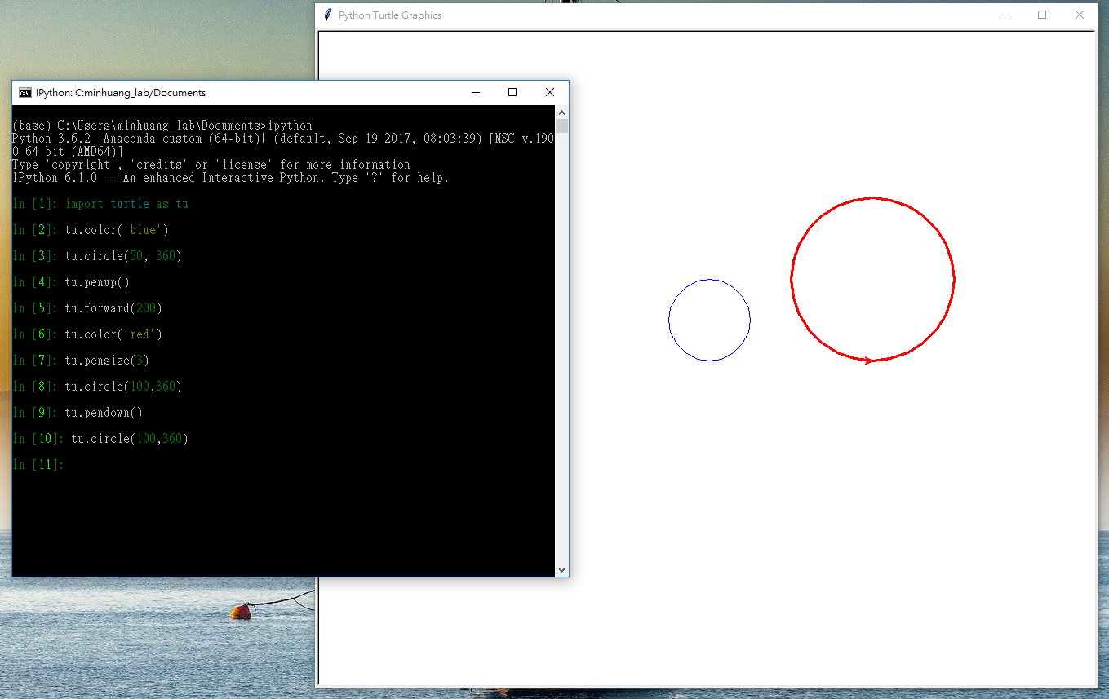
利用交談介面特性來繪圖

Slide 5
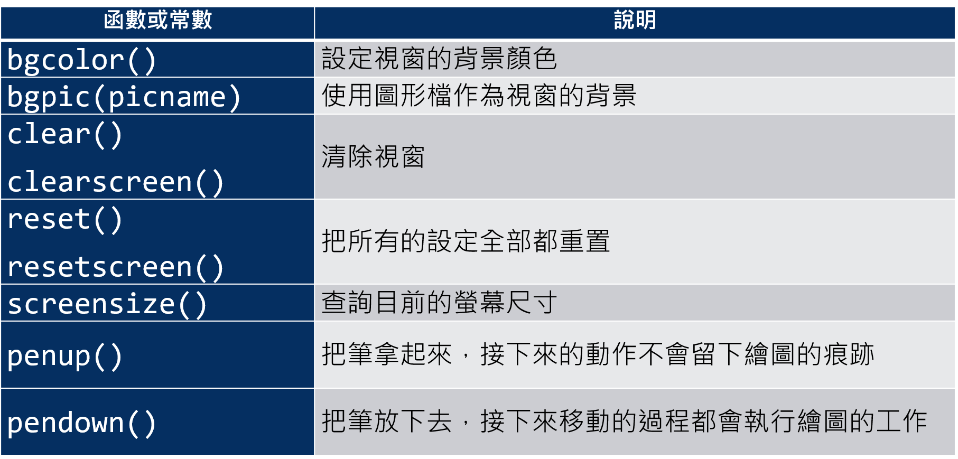
視窗操作相關函數

Slide 6
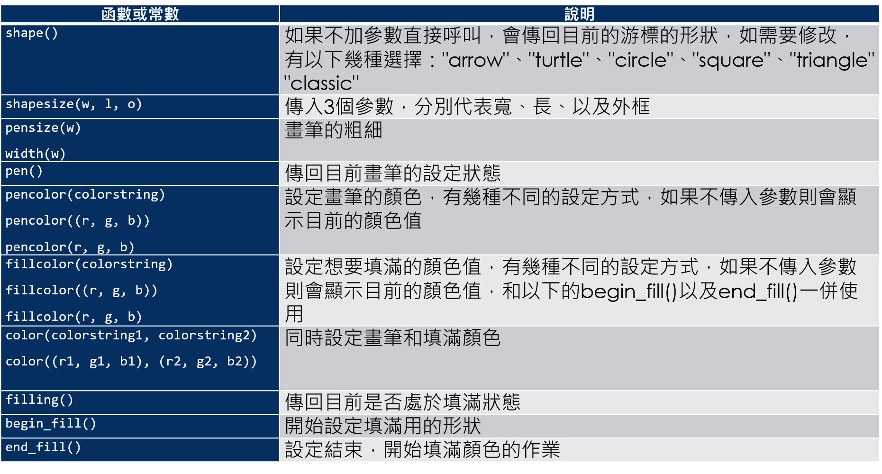
繪圖相關函數

Slide 7
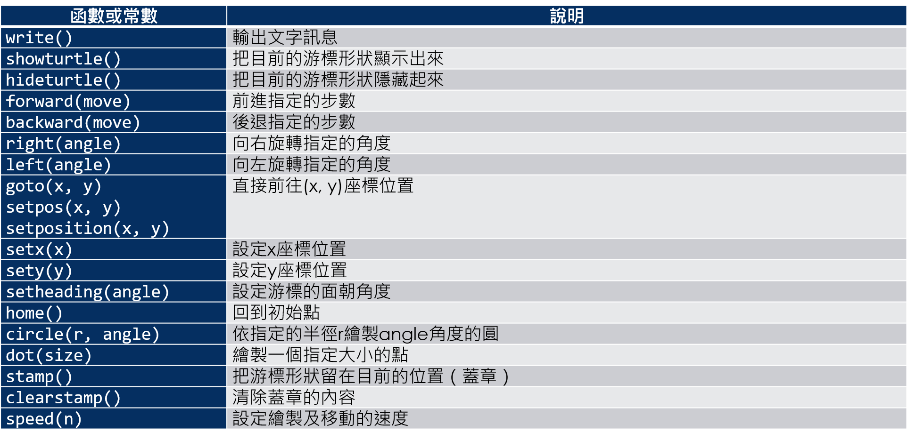
海龜動作相關函數

Slide 8
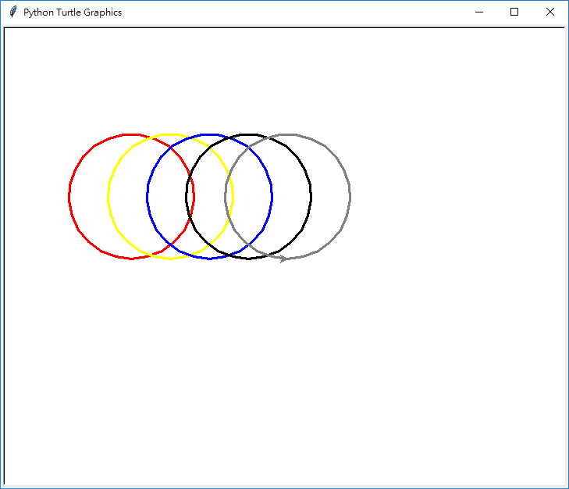
繪製幾何圖形
畫5種不同顏色的圓
import turtle as tu
circle_colors = ['red', 'yellow', 'blue', 'black', 'gray']
tu.pensize(3)
tu.penup()
for i in range(len(circle_colors)):
tu.goto(-200+i*50, 0)
tu.pendown()
tu.color(circle_colors[i])
tu.circle(80,360)
tu.penup()
tu.done()

Slide 9
畫5種不同顏色的圓 使用列舉的版本
import turtle as tu
circle_colors = ['red', 'yellow', 'blue', 'black', 'gray']
tu.pensize(3)
tu.penup()
for i, c in enumerate(circle_colors):
tu.goto(-200+i*50, 0)
tu.pendown()
tu.color(c)
tu.circle(80,360)
tu.penup()
tu.done()

Slide 10
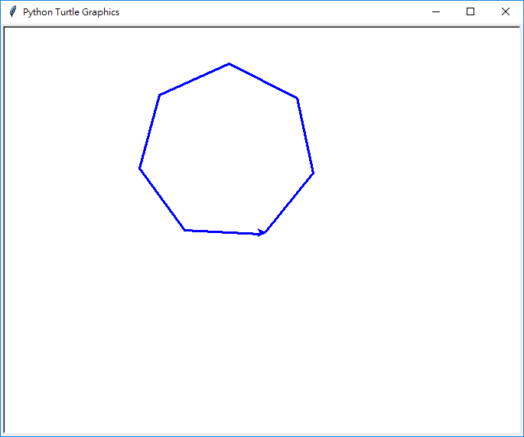
繪製多邊形
import turtle as tu
n = int(input("請問要畫幾邊形？"))
tu.pensize(3)
tu.color('blue')
for i in range(n):
tu.left(360//n)
tu.forward(100)
tu.goto(0,0)
tu.done()

Slide 11
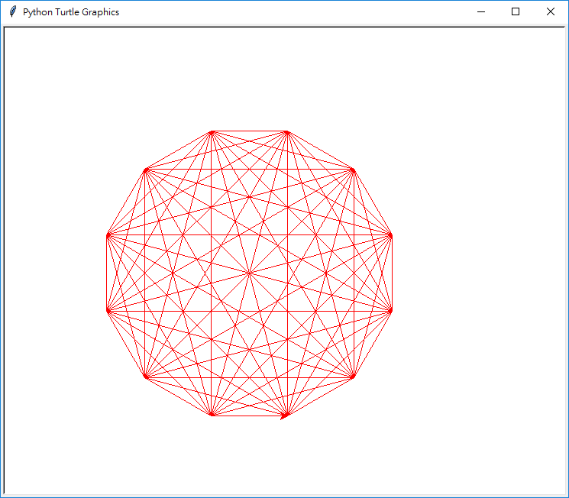
繪製多邊形毛線球
import turtle as tu
pos_list = list()
n = int(input("請問要畫幾邊形？"))
tu.color('red')
tu.speed(8)
tu.penup()
tu.goto(0,-200)
for i in range(n):
tu.left(360//n)
tu.forward(100)
pos_list.append(tu.pos())
for i in range(len(pos_list)):
for point in pos_list:
tu.penup()
tu.goto(pos_list[i])
tu.pendown()
tu.goto(point)
tu.done()

Slide 12
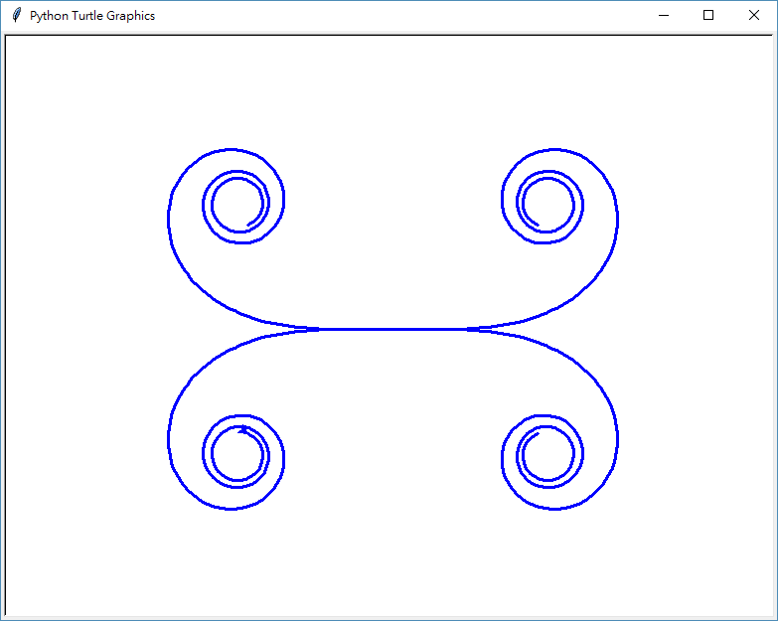
使用漸變技巧繪製幾何形狀
import turtle as tu
tu.speed(0)
tu.color('blue')
tu.pensize(3)
for i in range(150):
tu.left(i//10)
tu.forward(6)
tu.penup()
tu.home()
tu.pendown()
for i in range(150):
tu.right(i//10)
tu.forward(6)
tu.penup()
tu.home()
tu.pendown()
for i in range(150):
tu.right(i//10)
tu.backward(6)
tu.penup()
tu.home()
tu.pendown()
for i in range(150):
tu.left(i//10)
tu.backward(6)
tu.done()

Slide 13
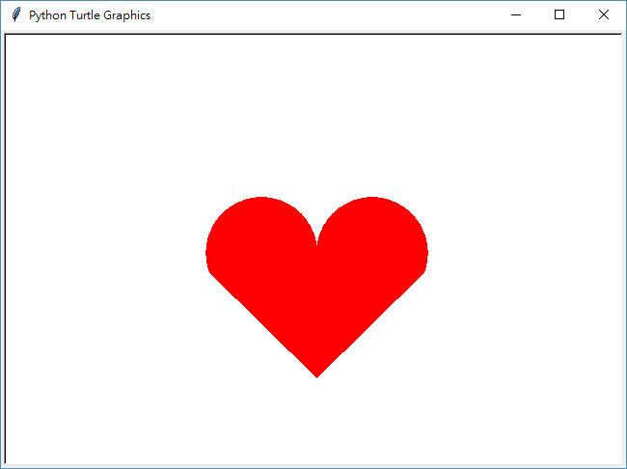
使用漸變技巧繪製 愛心圖形
import turtle as tu
tu.color('red')
tu.begin_fill()
tu.left(90)
for i in range(200):
tu.right(1)
tu.forward(1)
tu.goto(0,-130)
tu.goto(-110.96, -20.57)
tu.penup()
tu.goto(0,0)
tu.pendown()
tu.home()
tu.left(90)
for i in range(200):
tu.left(1)
tu.forward(1)
tu.end_fill()
tu.ht()
tu.done()

Slide 14
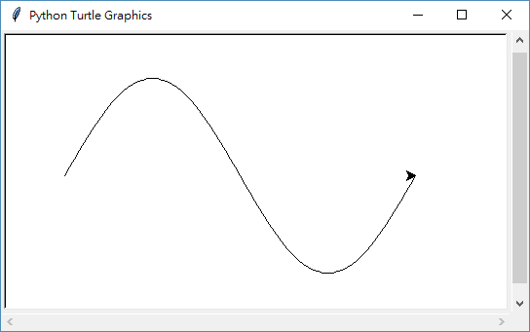
繪製數學函數圖形
繪製SIN函數圖形
import math
import turtle as tu
tu.speed(8)
tu.penup()
tu.goto(-200,0)
tu.pendown()
for d in range(0, 361, 5):
tu.goto(d-200, 100*math.sin(d*math.pi/180))
tu.done()

Slide 15
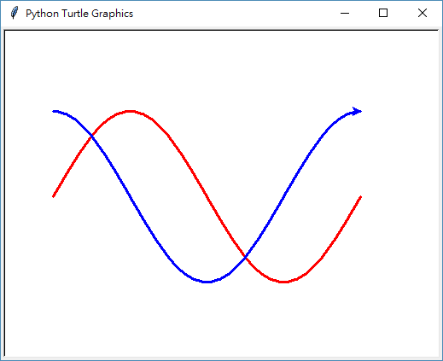
繪製SIN及COS函數圖形
import math
import turtle as tu
tu.speed(8)
tu.pensize(3)
tu.penup()
tu.goto(-200,0)
tu.color('red')
tu.pendown()
for d in range(0, 361, 5):
tu.goto(d-200, 100*math.sin(d*math.pi/180))
tu.penup()
tu.goto(-200,100)
tu.color('blue')
tu.pendown()
for d in range(0, 361, 5):
tu.goto(d-200, 100*math.cos(d*math.pi/180))
tu.done()

Slide 16
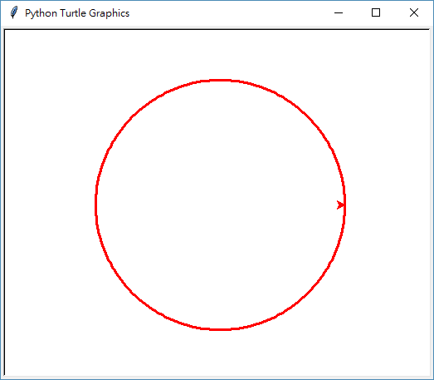
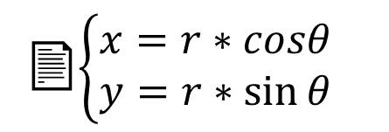
利用三角函數畫圓
import math
import turtle as tu
tu.speed(8)
tu.pensize(3)
tu.penup()
tu.goto(150,0)
tu.color('red')
tu.pendown()
for d in range(0, 361, 2):
x = 150*math.cos(d*math.pi/180)
y = 150*math.sin(d*math.pi/180)
tu.goto(x, y)
tu.done()
📄$\left\{\begin{aligned}&x=r∗cosθ \\ &y=r∗\sin{θ}\end{aligned}\right.$

Slide 17
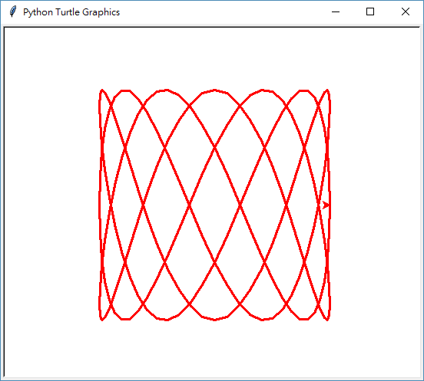
利用三角函數畫李沙育圖形
import math
import turtle as tu
tu.speed(8)
tu.pensize(3)
tu.penup()
tu.goto(150,0)
tu.color('red')
tu.pendown()
for d in range(0, 361, 2):
x = 150*math.cos(3*d*math.pi/180)
y = 150*math.sin(7*d*math.pi/180)
tu.goto(x, y)
tu.done()

Slide 18
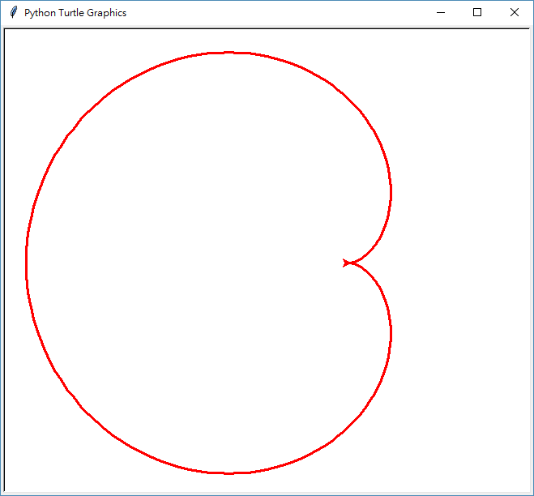
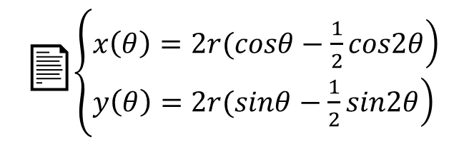
利用三角函數畫心臟線
import math
import turtle as tu
def th(degree):
return degree*math.pi/180
r = 100
tu.speed(8)
tu.pensize(3)
tu.penup()
tu.color('red')
for d in range(0, 361, 2):
x = 2*r*(math.cos(th(d)) - 0.5 * math.cos(2*th(d)))
y = 2*r*(math.sin(th(d)) - 0.5 * math.sin(2*th(d)))
if d:
tu.pendown()
tu.goto(x, y)
tu.done()
📄$\left\{\begin{aligned}&\left.x\left(θ\right)=2r(cosθ−\frac{1}{2}cos2θ\right) \\ &\left.y\left(θ\right)=2r(sinθ−\frac{1}{2}sin2θ\right)\end{aligned}\right.$

Slide 19
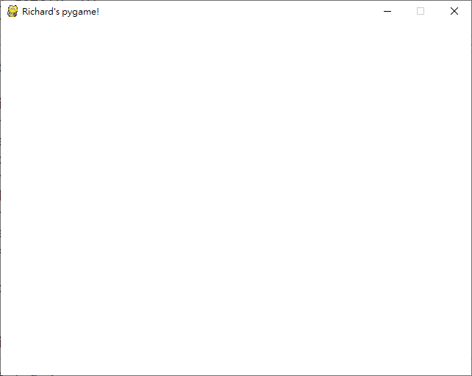
使用Pygame繪製圖形
pygame繪圖基本架構
import pygame as pg
pg.init()
screen = pg.display.set_mode((640, 480))
pg.display.set_caption("Richard's pygame!")
bk = pg.Surface(screen.get_size())
bk.fill((255,255,255))
screen.blit(bk, (0,0))
pg.display.update()
quit = False
while not quit:
for event in pg.event.get():
if event.type == pg.QUIT:
quit = True
pg.quit()

Slide 20
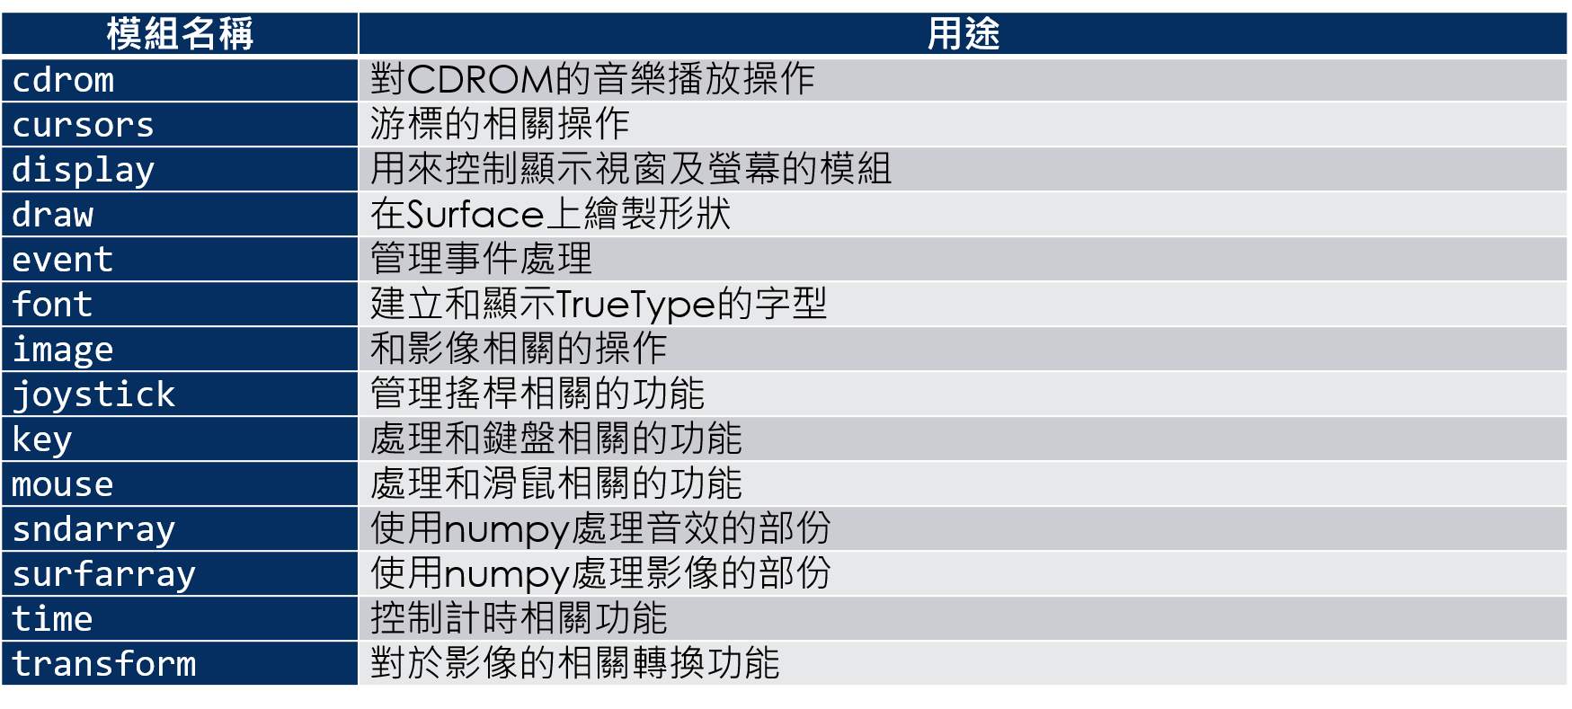
pygame模組列表

Slide 21
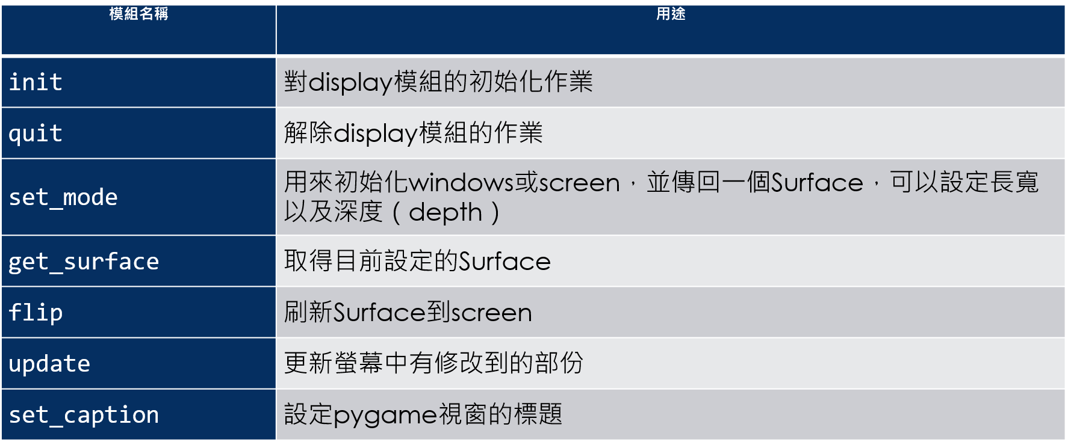
display模組常用函數

Slide 22
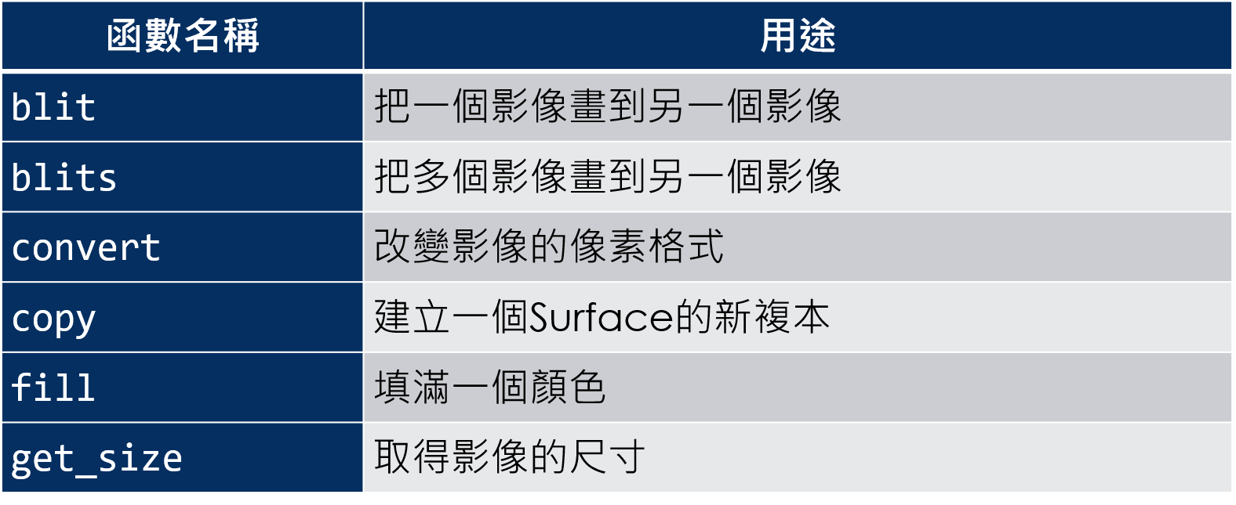
surface模組常用函數

Slide 23
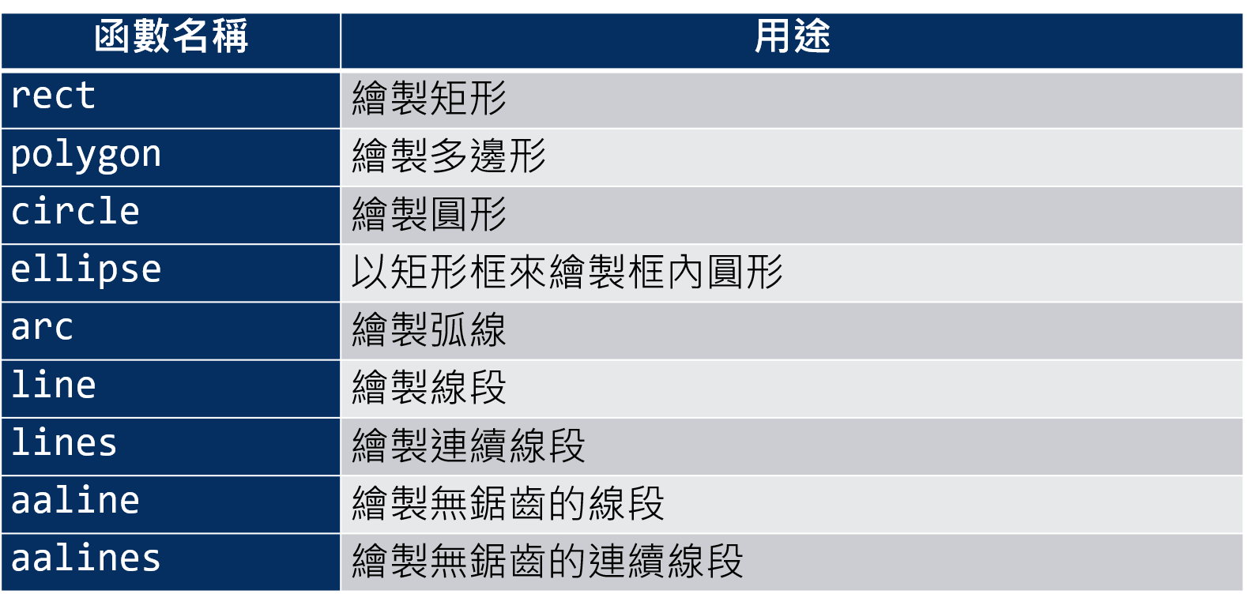
draw模組支援的繪圖函數

Slide 24
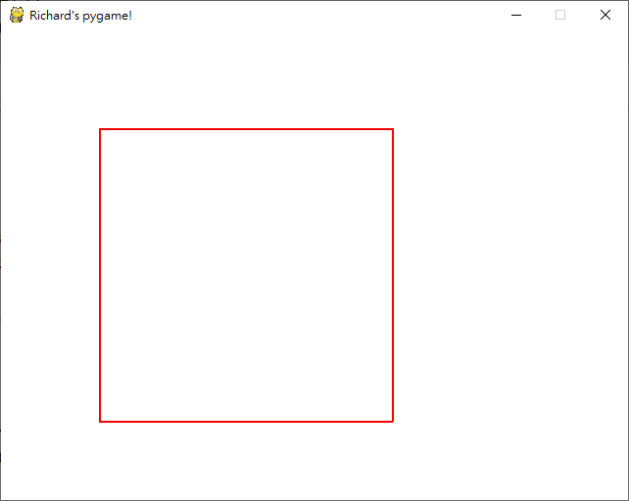
pygame繪製矩形
import pygame as pg
pg.init()
screen = pg.display.set_mode((640, 480))
pg.display.set_caption("Richard's pygame!")
bk = pg.Surface(screen.get_size())
bk.fill((255,255,255))
pg.draw.rect(bk, (255, 0, 0), (100, 100, 300, 300), 2)
screen.blit(bk, (0,0))
pg.display.update()
quit = False
while not quit:
for event in pg.event.get():
if event.type == pg.QUIT:
quit = True
pg.quit()

Slide 25
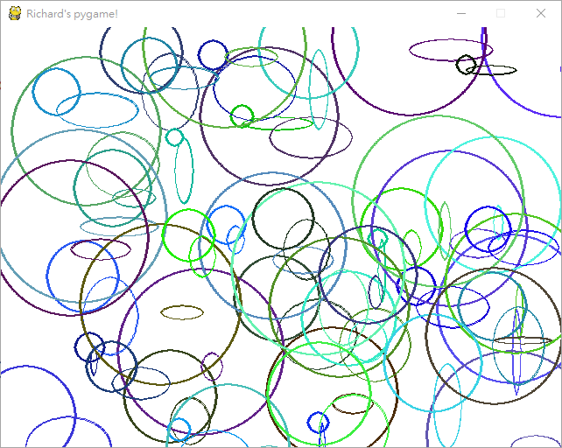
pygame隨機圖形
import random
import pygame as pg
pg.init()
screen = pg.display.set_mode((640, 480))
pg.display.set_caption("Richard's pygame!")
bk = pg.Surface(screen.get_size())
bk.fill((255,255,255))
for i in range(50):
r = random.randint(0, 255)
g = random.randint(0, 255)
b = random.randint(0, 255)
x = random.randint(0, 640)
y = random.randint(0, 480)
w = random.randint(10, 100)
h = random.randint(10, 100)
r = random.randint(10, 100)
pg.draw.ellipse(bk, (r, g, b), (x, y, w, h), 2)
pg.draw.circle(bk, (r, g, b), (x, y), r, 2)
screen.blit(bk, (0,0))
pg.display.update()
quit = False
while not quit:
for event in pg.event.get():
if event.type == pg.QUIT:
quit = True
pg.quit()

Slide 26
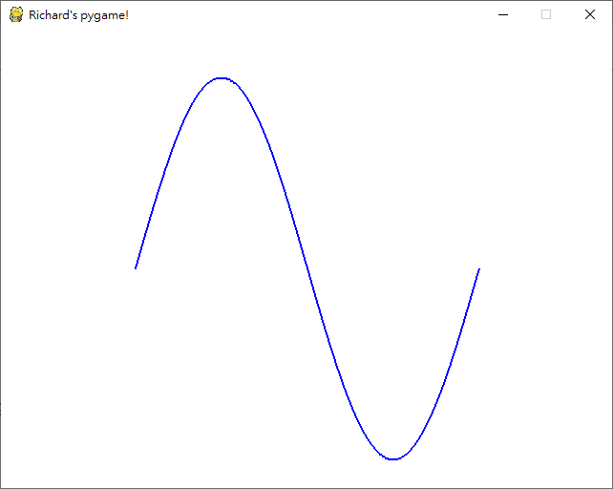
pygame繪製函數圖形
import pygame as pg
import math
pg.init()
screen = pg.display.set_mode((640, 480))
pg.display.set_caption("Richard's pygame!")
bk = pg.Surface(screen.get_size())
bk.fill((255,255,255))
lines = list()
for th in range(0, 361):
y = 250 - 200 * math.sin(th*math.pi/180)
lines.append((th+140, y))
pg.draw.lines(bk, (0, 0, 255), False, lines, 2)
screen.blit(bk, (0,0))
pg.display.update()
quit = False
while not quit:
for event in pg.event.get():
if event.type == pg.QUIT:
quit = True
pg.quit()

